Slide 1
Interesting Yet Hitherto Unknown World of Molecular Anions
Vaibhav S. Prabhudesai
TIFR Mumbai

Slide 2





Acknowledgement
Molecular Dynamics and Control using Photons and Electrons (MDCPE)
E. Krishnakumar (Now at RRI)
Krishnendu Gope (Now at HUJI)
Sramana Kundu (Now at Georgia Tech)
Vishvesh Tadsare
Daly Davis (Now at BARC)
Samata Gokhale
Technical Help
Yogesh Upalekar
Satej Tare
External Collaborators
Nigel Mason
  Open University, UK
Y. Sajeev
  BARC, Mumbai

Slide 3
Relevance of Negative Ion Studies
Planetary atmospheres – Environment
Laboratory and Astrophysical plasmas
Fusion research, Gas lasers
Semiconductor electronics
High power switches, Dielectrics
Analytical techniques – Mass spectrometry
Isotope separation, Neutral beam generation
Radiation Physics and Dosimetry

Slide 4
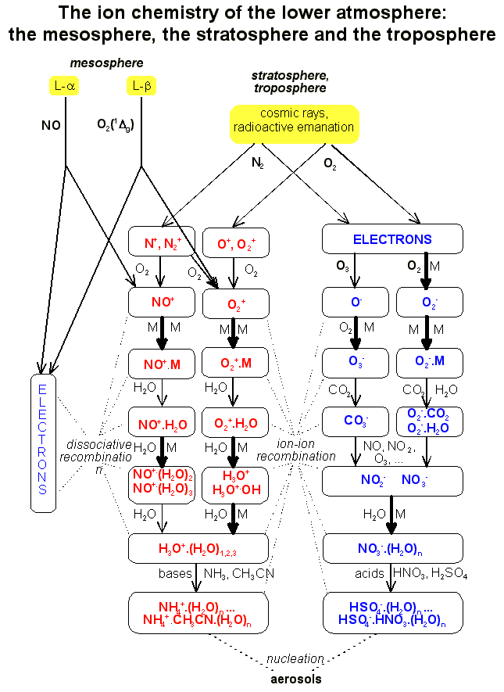

Slide 5

O⁻, O₂⁻, O₃⁻, CO₂⁻, NO_{x}⁻, etc.

Slide 6
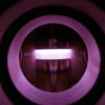
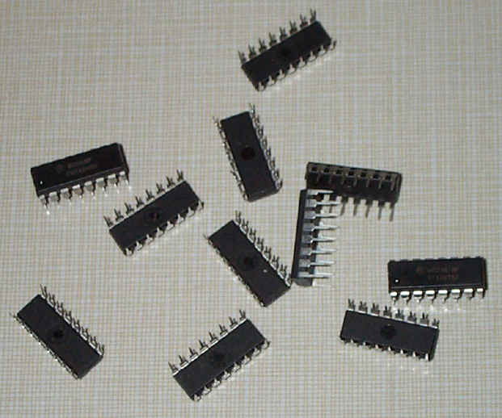
Etching (IC’s, cleaning):
CF₄, C₂F₆, C₃F₈, SF₆, O₂…
Deposition:
CH₄, SiH₄, NH₃

Slide 7
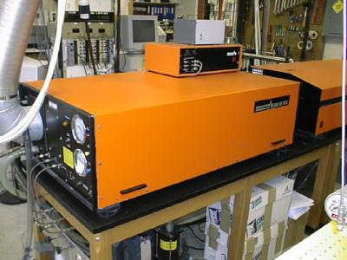
Excimer media: Ar, Kr, Xe + F₂, Cl₂
_{Discharge lamps}

Slide 8
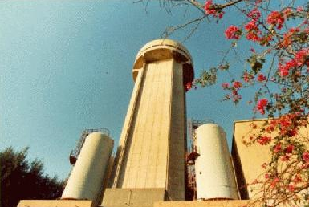
Gaseous Dielectrics

Slide 9
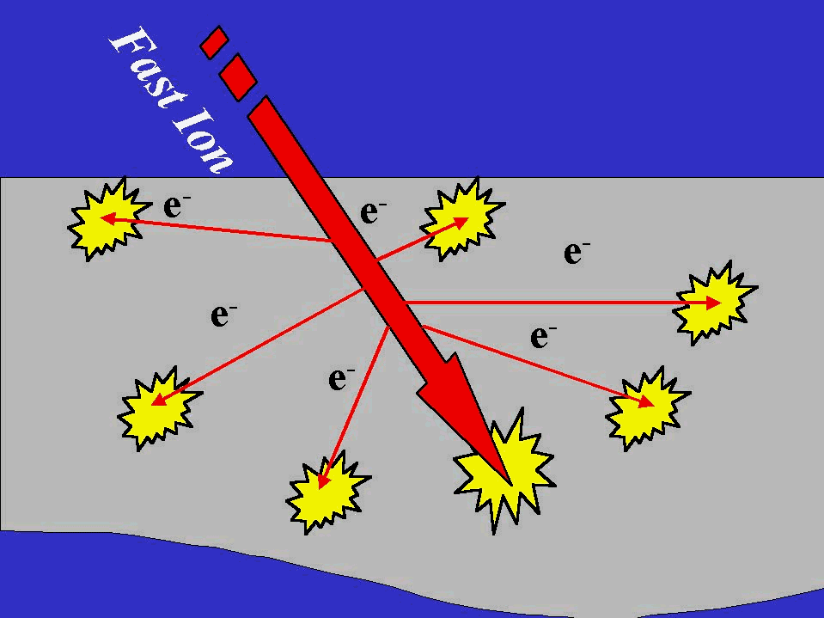
Radiation Damage
5 x 10 ⁴ electrons per MeV energy of the radiation
Electron energy varying upto ~ 20 eV

Slide 10
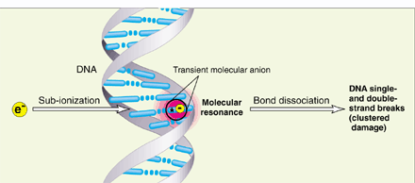
A sting in the tail of electron tracks

Slide 11
Negative Ion Resonances
Resonance
X
X–
E. A.
(Electron Affinity)
Conventional optical spectroscopy fails in studying these resonances
Studied through electron collisions

Slide 12
Basic electron collision processes in molecules
Elastic scattering AB + e ⁻ AB + e ⁻
Inelastic scattering
  Excitation AB + e ⁻ AB* + e ⁻
  Ionization AB + e ⁻ AB⁺ + 2e ⁻
  Dissociative ionization AB + e ⁻ A + B ⁺ + 2e ⁻
  Dissociation AB + e ⁻ A + B + e ⁻
  Dissociative excitation AB + e ⁻ A + B* + e ⁻
  Polar dissociation AB + e ⁻ AB* + e ⁻
  A ⁺ + B ⁻
  Dissociative electron attachment AB + e ⁻ (AB ⁻) * A + B ⁻
  Bond breaking by catalytic electron A + B + e ⁻
Most effective way of converting kinetic energy into chemical energy

Slide 13
Schematic of Electron Molecule Collision for DEA
Temporary negative ion (TNI)
e ⁻
((A-B)⁻)*
A-B
Dissociation
Auto-detachment
A + B⁻
(A-B)*
+ e ⁻
Dissociative Electron Attachment
(Negative ion mass spectrometry)
Resonant Scattering
(Electron spectroscopy)

Slide 14
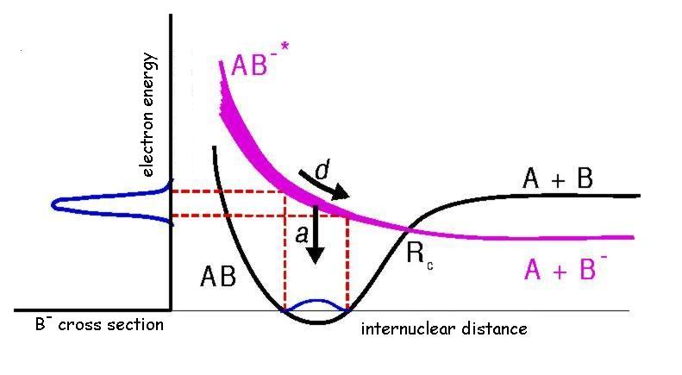
DEA Cross Section
Prabhudesai et al Phys. Rev. Lett. 95, 143202 (2005)

Slide 15
Quantum Coherence in Dissociative Electron Attachment
Dissociative electron attachment to molecular hydrogen

Slide 16
Dissociative Electron Attachment to H₂
Krishnakumar et al. PRL (2011)
For third resonance at 14 eV
$H_{2}+e → H^{−}\left({}_{ }^{1}S\right)+H(2l)$

Slide 17
Angular Distribution of Fragments
Angular distribution of the DEA fragment have general form:
k : incident electron momentum; a_{lμ} (k) : energy dependent expansion coefficient; Y_{lμ}(θ,φ) : spherical harmonics
Λ_{i} and Λ_{f} are the projection of electronic orbital angular momentum along the molecular axis for initial and final states
Only even l for symmetric or only odd l for antisymmetric transitions under inversion in homonuclear diatomic molecules
μ = Λ_{f} − |Λ_{i}|

Slide 18
Angular Distribution of Fragment Ions
e⁻
A
B⁻
A-B
(A-B)⁻
θ

Slide 19
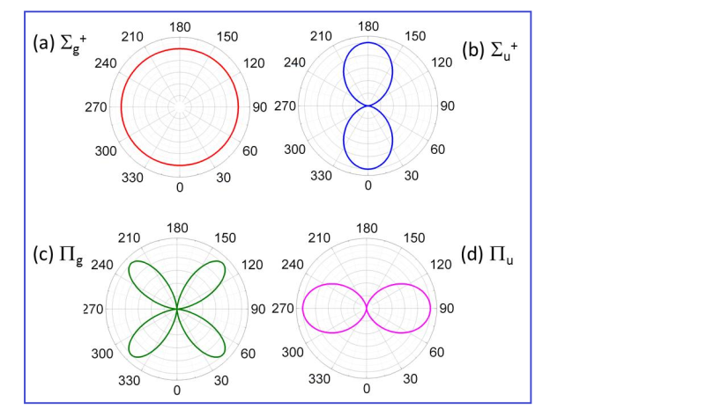
Angular Distributions in Pictures
Expected angular distributions homonuclear diatom
H₂ ground state is ${}_{ }^{1}{Σ_{g}^{+}}$

Slide 20
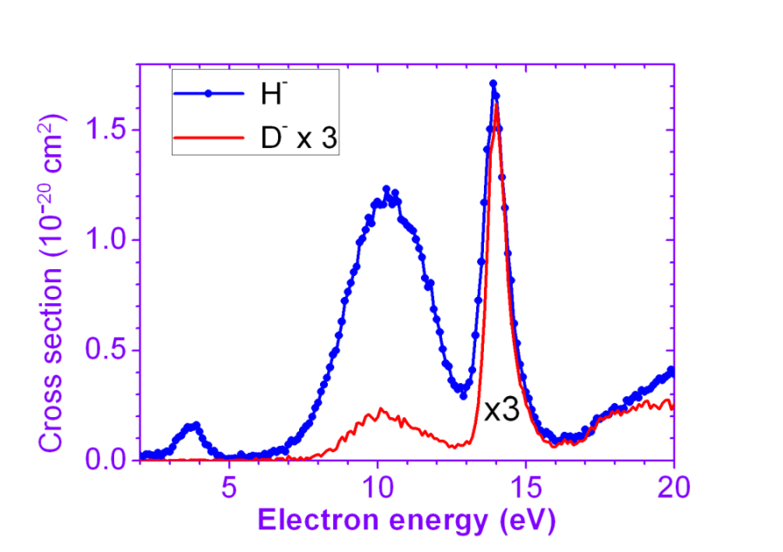
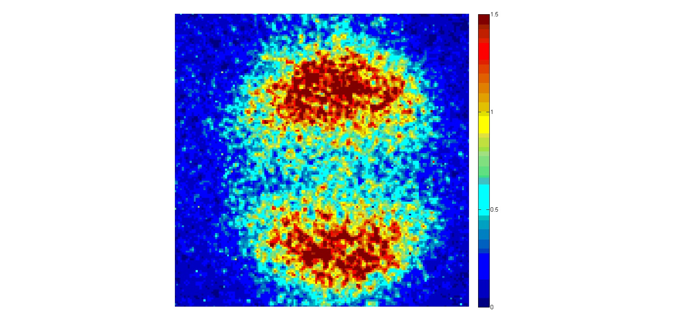
The 4 eV Resonance
e⁻
²Σ_{u}⁺

Slide 21
Potential Energy Curves

Slide 22
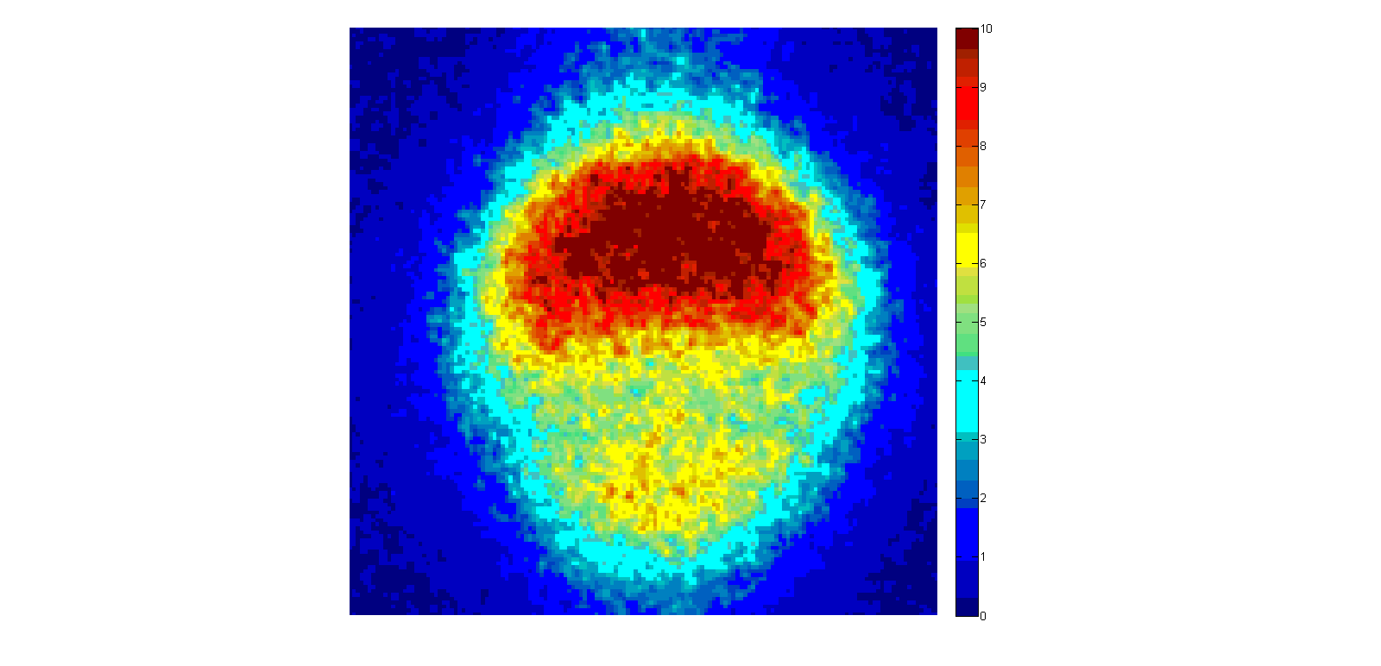
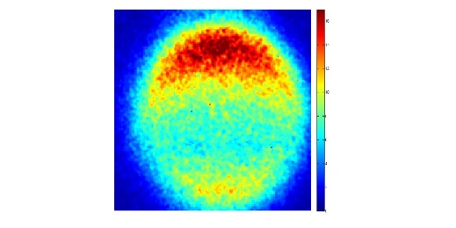
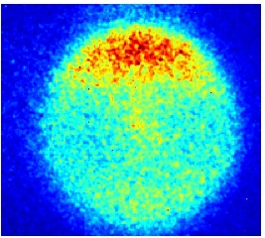
The 14 eV Resonance
14.5 eV | 15 eV | 15.5 eV
e⁻
4.5 eV

Slide 23
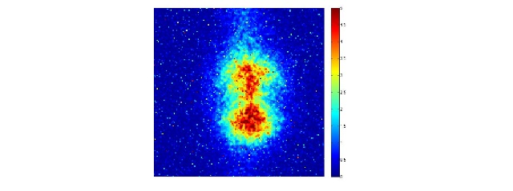
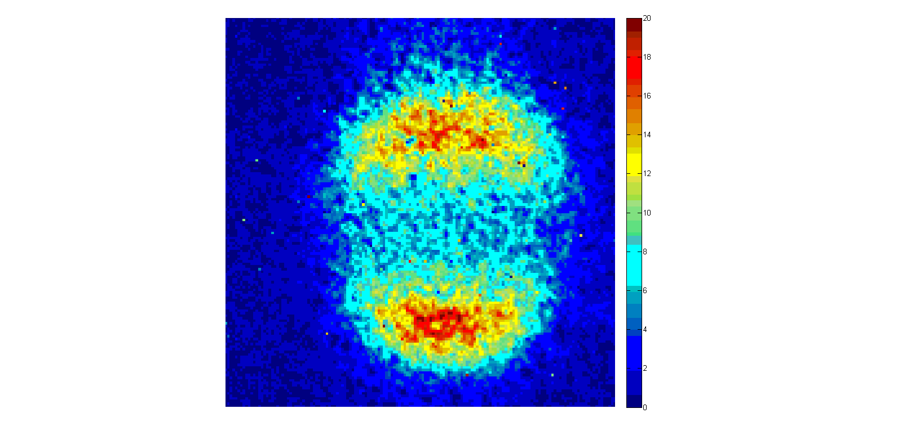
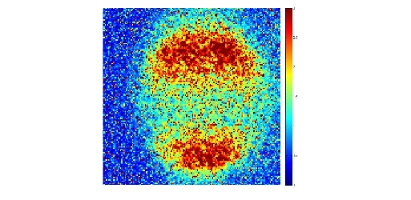
Momentum Images
H₂
14.5 eV | 15 eV | 15.5 eV
D₂
14.0 eV | 14.5 eV | 15 eV
e⁻

Slide 24
How can the symmetry be broken ?
$$H_{2}\left({}_{ }^{1}{Σ_{g}^{+}}\right)+e^{−} \left(E\right)→{\left[H_{2}^{−}\right]}^{∗}\left({}_{ }^{2}{Σ_{u}^{+}\left(p\right)}+{}_{ }^{2}{Σ_{g}^{+}\left(s\right)}\right)$$
$→H^{−}\left({}_{ }^{1}S\right)+H\left(n=2\right)$
Angle differential cross section
For ${}_{ }^{1}{Σ_{g}^{+}}+s−wave→{}_{ }^{2}{Σ_{g}^{+}}$ | For ${}_{ }^{1}{Σ_{g}^{+}}+p−wave→{}_{ }^{2}{Σ_{u}^{+}}$
$$I\left(θ\right)={\frac{1}{2}σ}_{{DEA}_{g}}$$ | $$I\left(θ\right)={\frac{3}{2}σ}_{{DEA}_{u}}\cos^{2}(θ)$$
For coherent excitation of the two resonances
$$I\left(θ\right)={\frac{1}{2}σ}_{{DEA}_{g}}+{\frac{3}{2}σ}_{{DEA}_{u}}\cos^{2}\left(θ\right)+\sqrt{3}cosδ cosθ\sqrt{σ_{{DEA}_{g}}σ_{{DEA}_{u}}}$$
δ is the phase difference between the two channels.

Slide 25
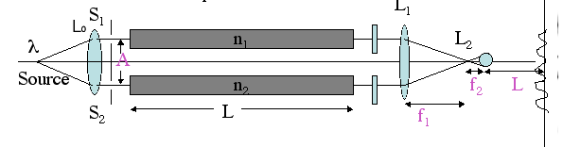
Contrast of the Interference Pattern
The relative phase between the two quantum paths
  Intrinsic phase difference between absorbed partial wave for the incoming electron
  Potential scattering before capture of the electron
  With common start and end point the wavepackets following two different potential energy curves
Relative amplitudes from the paths
  Capture cross section for each resonance
  Dissociation time and Corresponding lifetime of ions against autodetachment

Slide 26
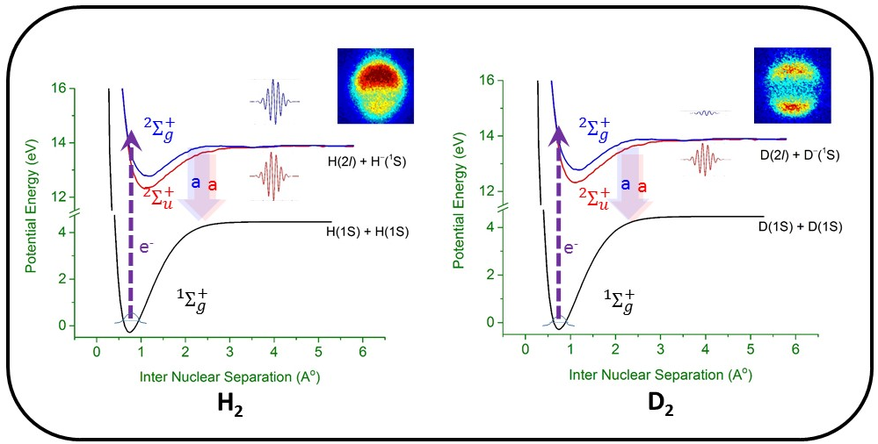
Interfering Quantum Paths

Slide 27
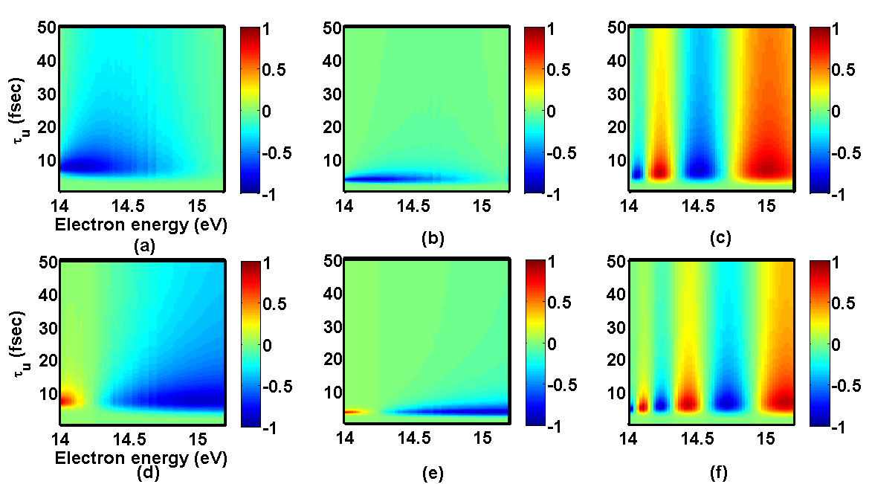
Estimate of the Symmetry Breaking
H₂
D₂

Slide 28
Breaking Inversion Symmetry
Coherent excitation to a state by more than one path
  Resulting interference between the paths give control over the out put
If the paths are of opposite parities
  Results in inversion symmetry breaking of the dissociation
Kling et al, Science, 312, 246 (2006)
Wu et al, Phys Rev A, 87, 023406 (2013)

Slide 29
Some interesting points
The attaching electron is from an incoherent beam
Multiple channels of attachment through different angular momentum transfers
The coherence in the superposition of the anion states is through coherence in the partial waves
Will the lifetime of the shorter lived resonance affect the lifetime of the longer lived resonance?
Ideal system to explore the quantum effect as all three electrons and 2 nuclei participate in the process!
Decay of superposition of two resonances
Frishman & Shapiro, PRL 87, 253001 (2001)

Slide 30
What about the electron ejection channel?
Ehrhardt and Weingartshofer, Z Phys, 226, 28 (1969)
Weingartshofer et al, Phys Rev A, 2, 294 (1970)

Slide 31
Site Selectivity in
Dissociative Electron Attachment
Dissociative electron attachment to organic molecules

Slide 32
Origin Of Hydride Ion
CH₃COOH
CH₃COOD
H
O
H
O
H
C
C
H
C
C
H
O
H
O
H
D

Slide 33
Site Selectivity in Dissociative Electron Attachment (DEA)
Observation of bond orientation and site selectivity in DEA
  O-H vs C-H bonds
  N-H vs C-H bonds
The resonances observed in H⁻ channels for organic molecules are found to follow the precursors of the functional groups
  O-H to follow H₂O
  N-H to follow NH₃
  S-H to follow H₂S
  C-H to follow CH₄

Slide 34
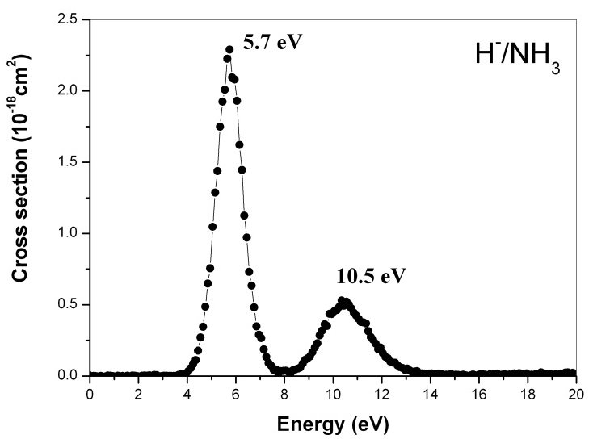
Hˉ from Amine
H⁻ / CH₄
CH₃CH₂CH₂NH₂
H⁻ / NH₃
Prabhudesai et al. PRL 95, 143202 (2005)

Slide 35
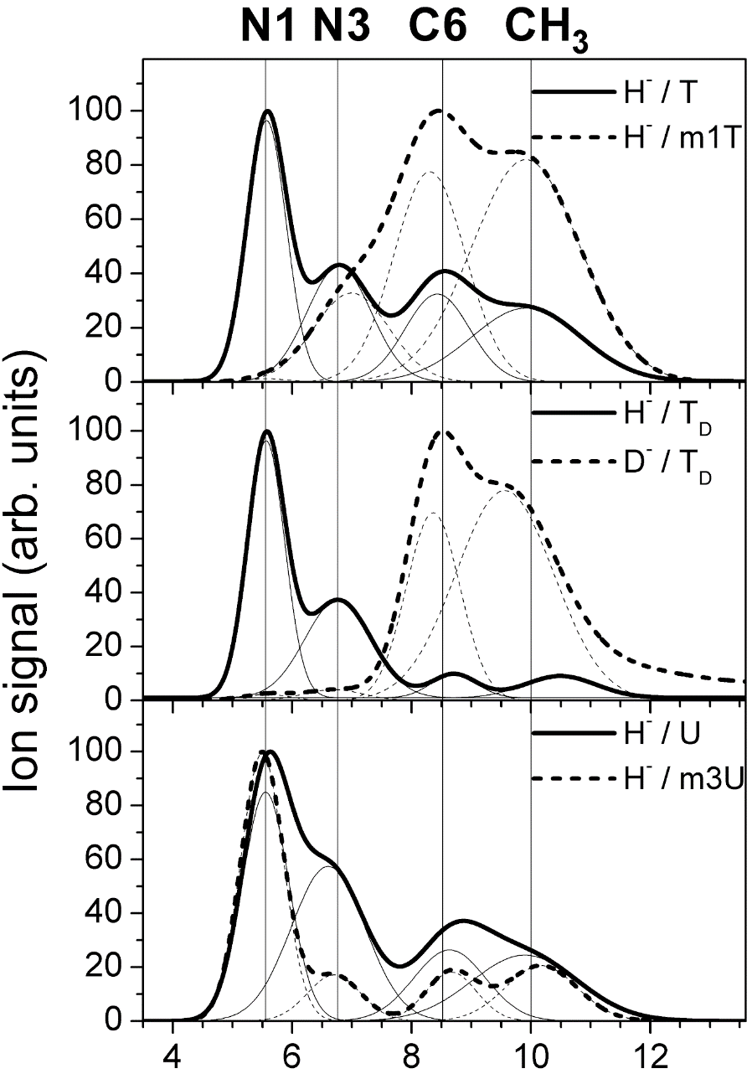
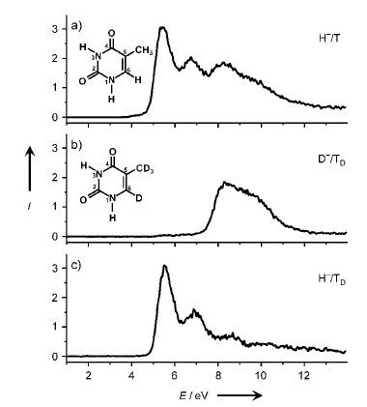
Site Selectivity In DEA Beyond Threshold
Ptasin´ska et. al. Ang. Chem. Int. Ed. 44, 1647 (2005)

Slide 36
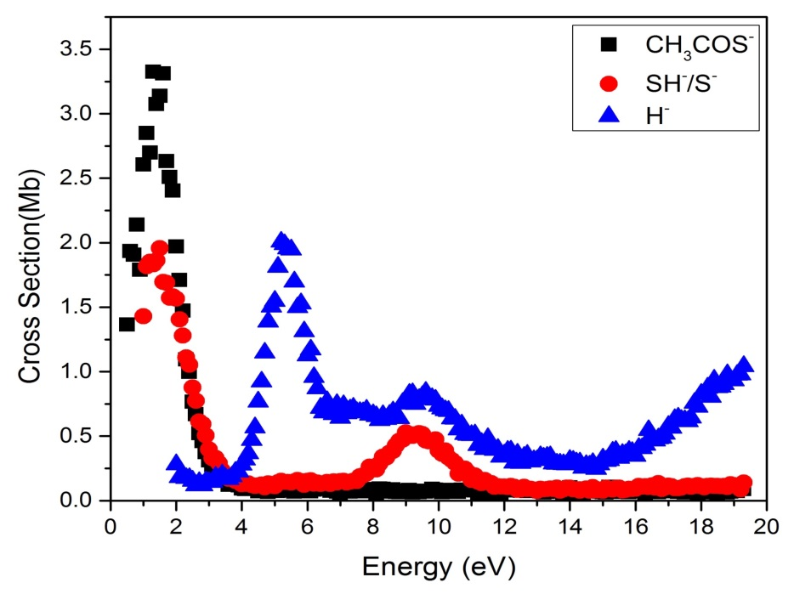
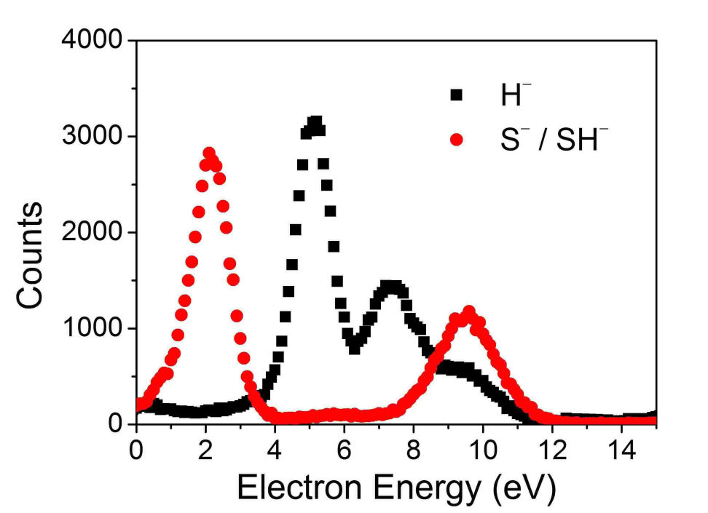
For Thiol Group
Thioacetic acid (CH₃COSH)
Hydrogen Sulphide (H₂S)
H
O
N. B. Ram et al PCCP 13, 16321 (2011)
H
C
C
H
S
H

Slide 37
Free Electron as a Catalyst
Bond breaking by catalytic electron in formic acid

Slide 38
Catalyst
Reduces activation barrier
Does not modify the standard Gibbs free energy change in the reaction
It is retrieved back at the end of the reaction
Free electron can act as a catalyst is theoretically predicted earlier
IUPAC Gold Book
D. Davis et al., Angew. Chem., Int. Ed., 2011, 50, 4119
D. Davis et al., Angew. Chem., Int. Ed., 2012, 51, 8003

Slide 39
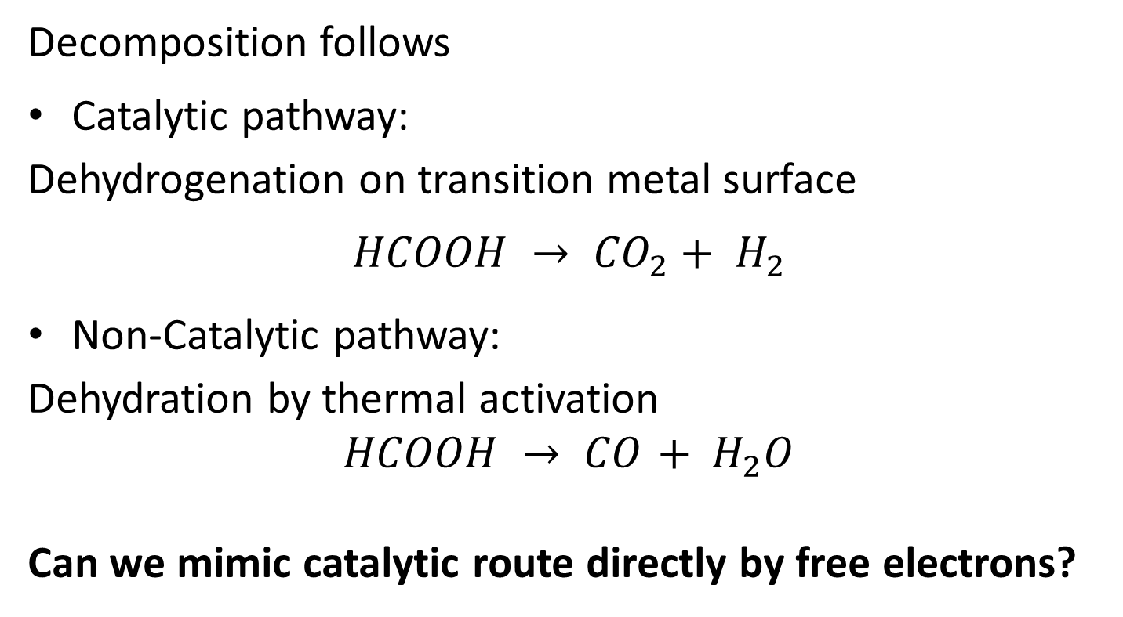
Formic Acid
Decomposition follows
Catalytic pathway:
Dehydrogenation on transition metal surface
$$HCOOH → {CO}_{2}+ H_{2}$$
Non-Catalytic pathway:
Dehydration by thermal activation
$$HCOOH → {CO}_{ }+ H_{2}O$$
Can we mimic catalytic route directly by free electrons?

Slide 40
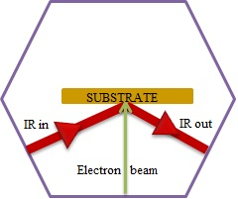
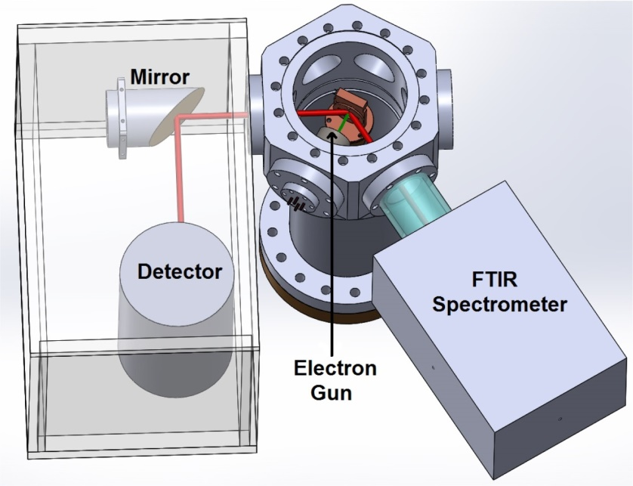
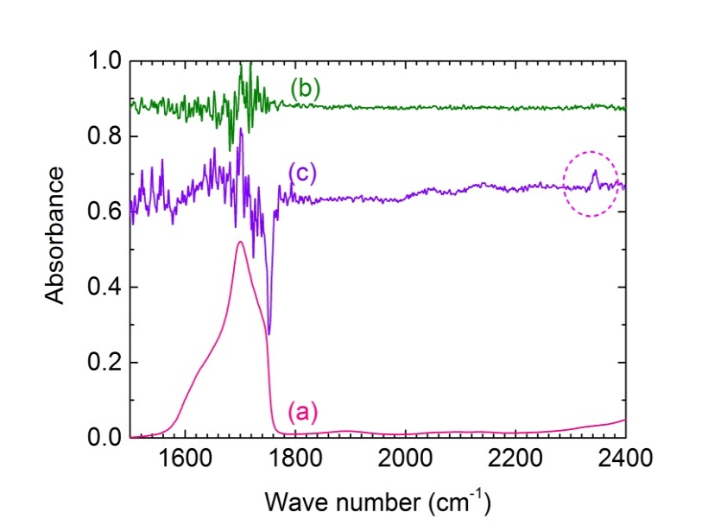
Electron Irradiation of Formic Acid Film

Slide 41
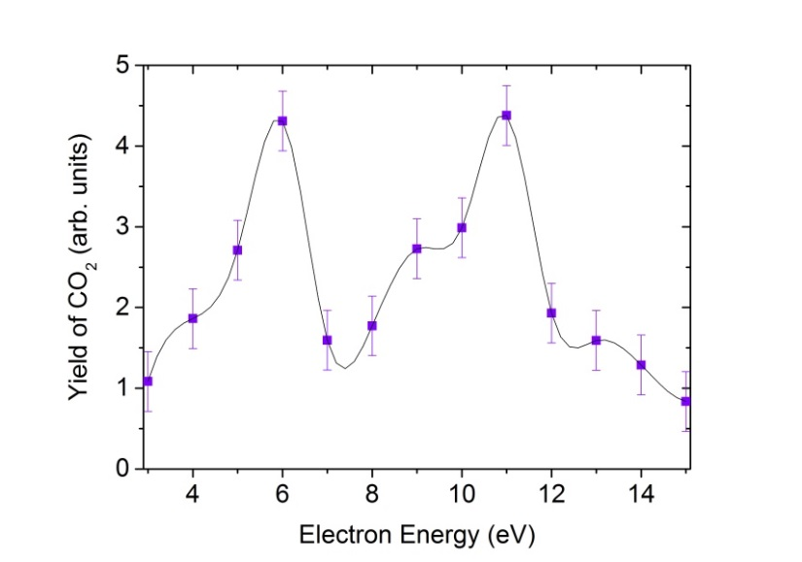
CO₂ formation from HCOOH

Slide 42
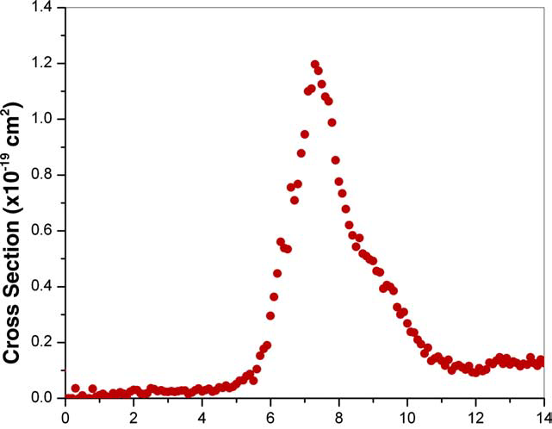
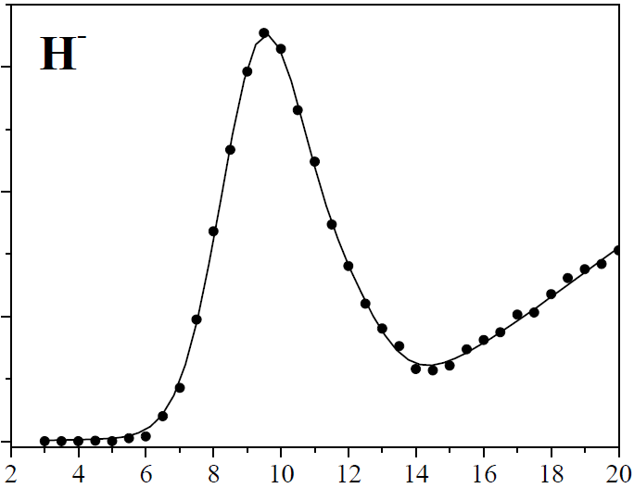
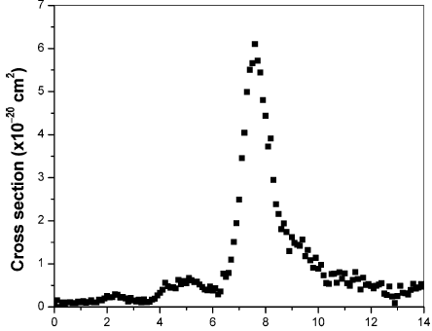
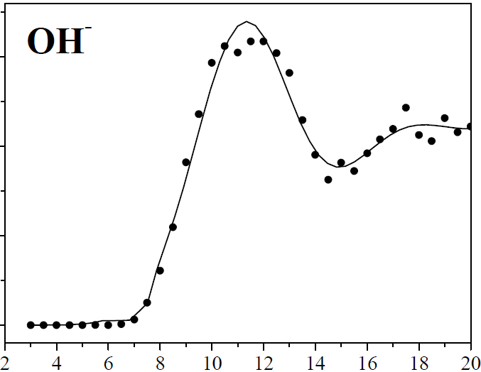
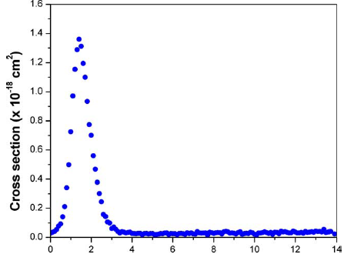
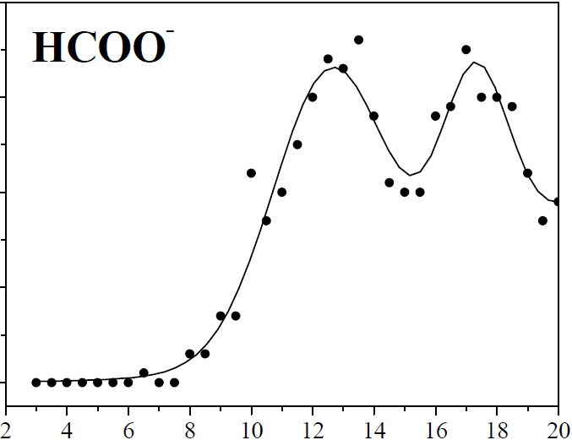
Gas Phase
Condensed Phase
H–
O–/ OH–
HCOO–

Slide 43
Mechanism of catalytic activity

Slide 44
To Summarise
There are many unexplored facets of anion dynamics
Quantum coherence in attachment of incoherent electron beam
Site selectivity in dissociation of organic molecules
Role in catalytic action of free electron
Next
Can we control chemical reactions using electrons?

Slide 45
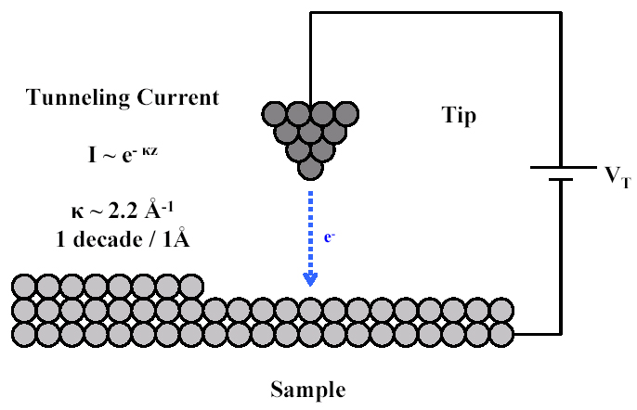
Scanning Tunneling Microscope
Binnig and Rohrer: Nobel Prize 1986

Slide 46
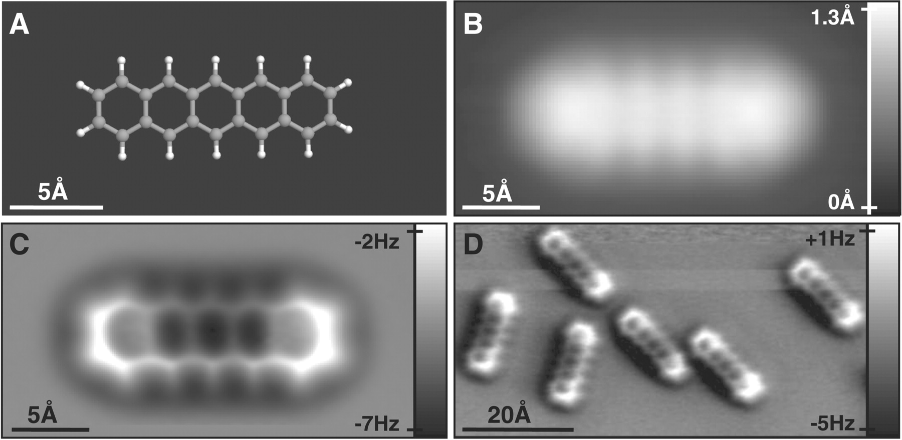
Can we see molecules using electrons?
Pentacene

Slide 47
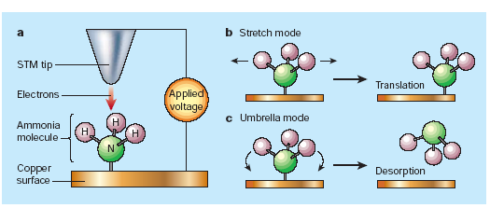
Controlling Molecular Motion With Scanning Tunneling Microscope

Slide 48
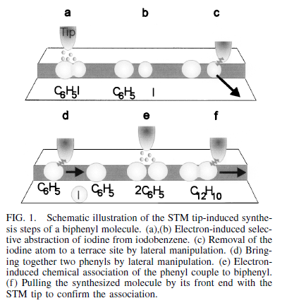
Single Molecule Chemistry!

Slide 49
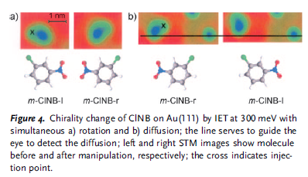
It can change left handed molecule to right handed molecule

Slide 50
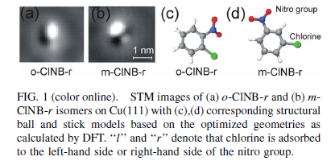
Play with the molecules!

Slide 51
Thank you

